Slide 1







What’s in it ?
Brief explanation of word2vec
Understanding all the functionalities of node2vec in detail
Flow of node2vec with an example
My simple and short implementation of node2vec
Visualisation of embeddings generated for Karate Club network
Visualisation of embeddings for Ironmarch
Idea to generate embedding when a new node arrives.

Slide 2

Word2vec (brief explanation)

Slide 3
Word2Vec - The Skip-Gram Model
We’re going to train a simple neural network with a single hidden layer to perform a certain task, but then we’re not actually going to use that neural network for the task we trained it on! Instead, the goal is just to learn the weights of the hidden layer–we’ll see that these weights are the “word vectors” that we’re trying to learn.

Slide 4


Slide 5
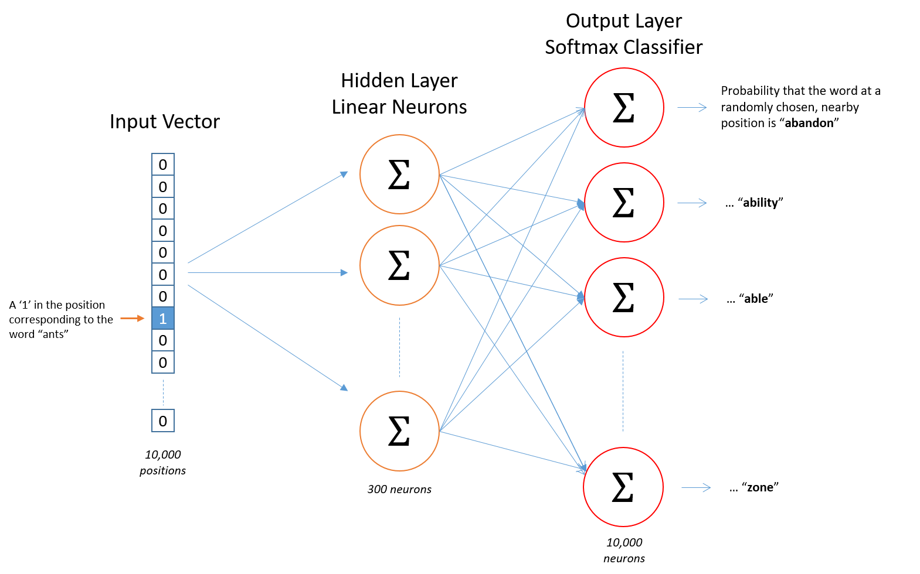

Slide 6
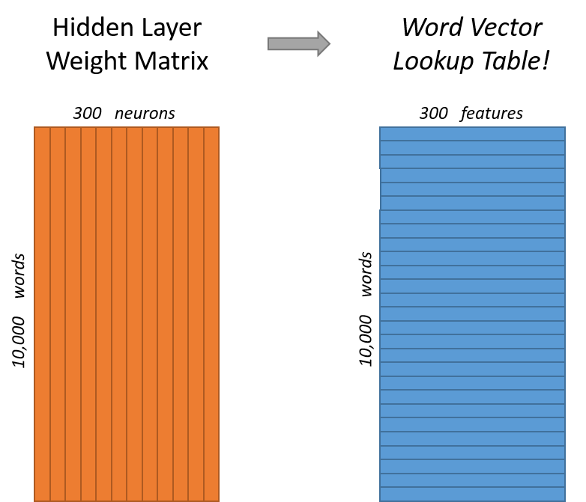

Slide 7
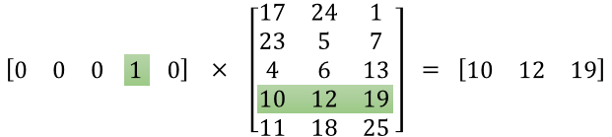
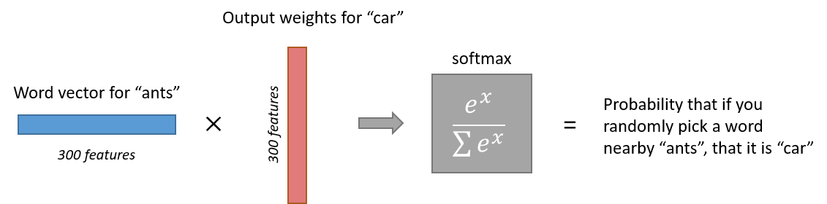

Slide 8
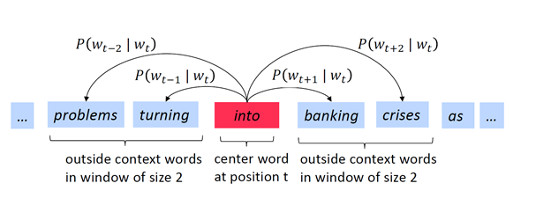
So, in order to learn the representation of a word, we will try to learn the context in which a particular word appears and will hope that this word’s vector will be similar to the vector of the context words.
Skip-gram Algorithm
The main idea behind the algorithm is that first, we will randomly initialize the vector for each word in the vocabulary.
After that, we will go through each position t and we will define the center word at that position as c and its context word as o. To identify the context words, we will define a window of size m which means our model will look at words in position t-m to t+m as the context.

Slide 9
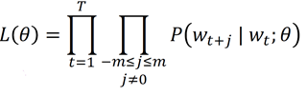
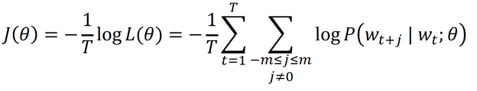
Once we have all the context words at position t, we will try to maximize the likelihood of the context words given the center word, i.e. we will calculate the probability of our model predicting the context words given the center word and we will try to maximize that probability. This likelihood can be represented using this formula:
To put this equation in a form such that it is easy to take derivatives and make it a minimization problem, we will just take the log of the equation and multiply it by -1 to calculate the -ve log-likelihood.
Note that, now multiplication will turn to summation as we have taken the log

Slide 10
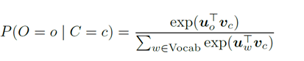
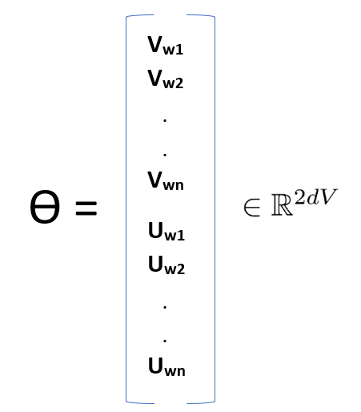
Now the question is how can we calculate the probability of context word given the center word?
To do that, we will represent each word by two sets of vectors, Uw and Vw. We will use Uw when w is the context word and Vw when w is the center word. Using these two vectors, our probability equation for center word o and context word c will look like this:
As we can see, this is an example of the softmax function. In the numerator, we have the dot product of word o and c which captures the similarity between these two vectors. Higher the similarity, higher will be the probability. Denominator gives us a way to normalize the values of probability over entire vocabulary so that it all adds up to 1
Now that we have our loss function in-place, now comes the part of training the model. If we look at our likelihood equation above we can see that we have only one model parameter in our equation ϴ. This is a long vector which contains both v and u vectors of length d for all the words

Slide 11
Then it will use gradient descent algorithm to walk down the hill and change all the weights slowly to maximize our likelihood. We will get the direction in which we have to move to change the weights by taking the derivative of our loss function with respect to both U and V.

Slide 12
Node2vec

Slide 13
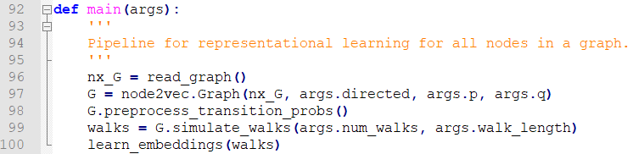
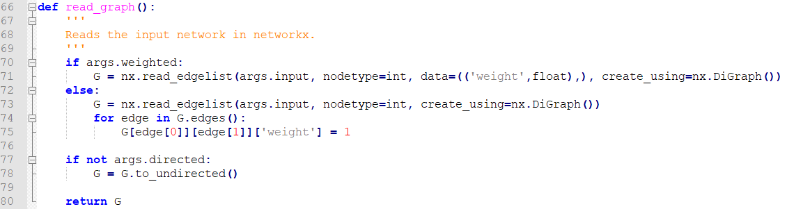
Pipeline & Graph using network -

Slide 14
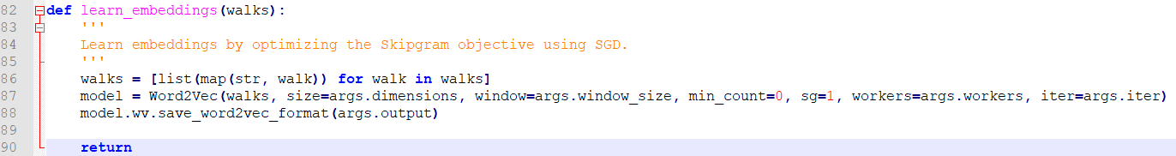
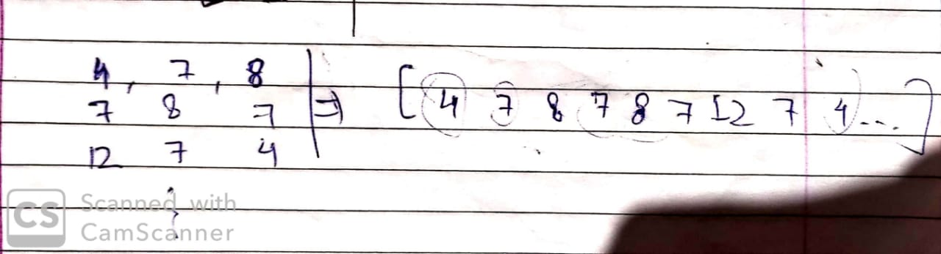
Calling Word2vec to learn embeddings -
After performing walks a list of a large array like a very big paragraph is given as input to word2vec. In this case the sequence consists of node numbers instead of words.
e.g –
Word i/p : “[I am a student named Akash]”
Our i/p : “[1 7 8 7 9 23 21 7 2 7 43]”

Slide 15
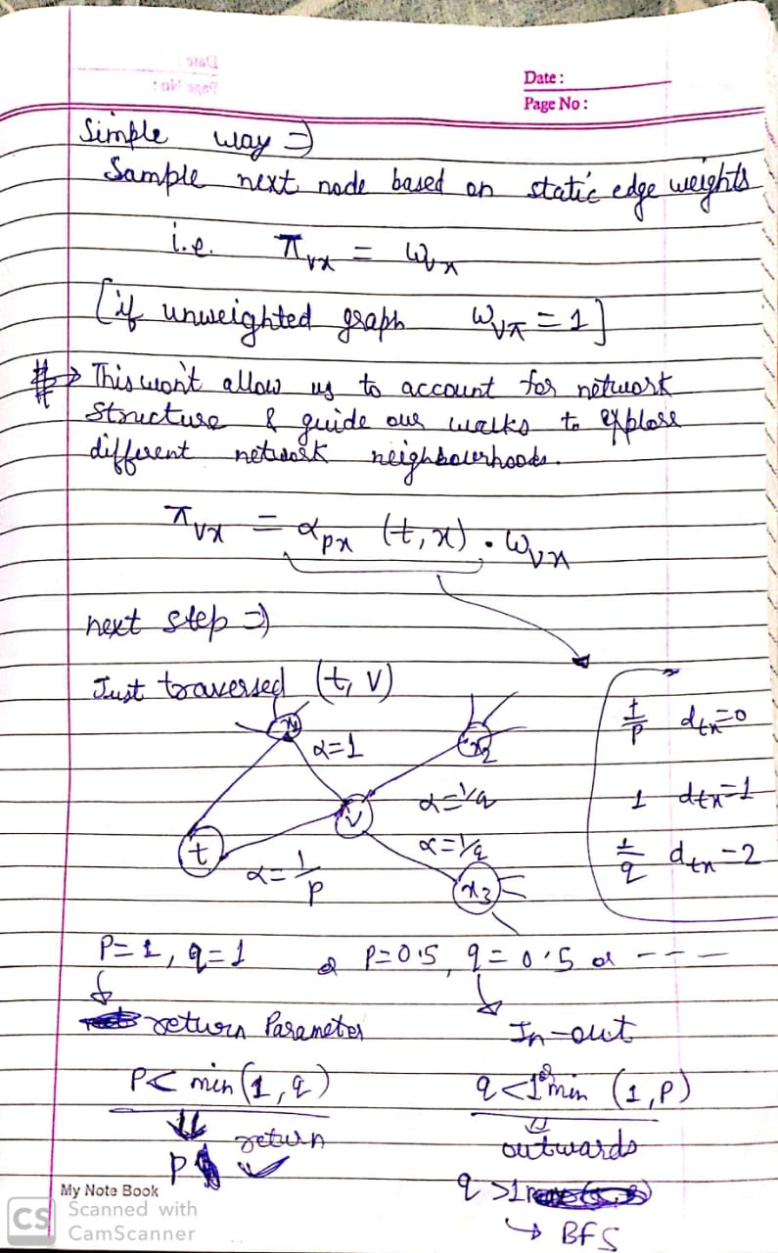
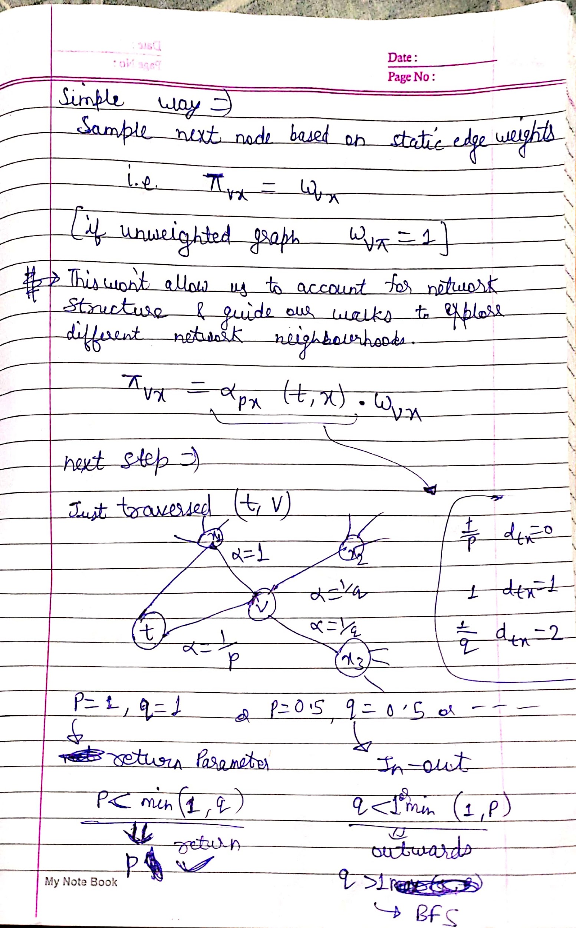

Slide 16
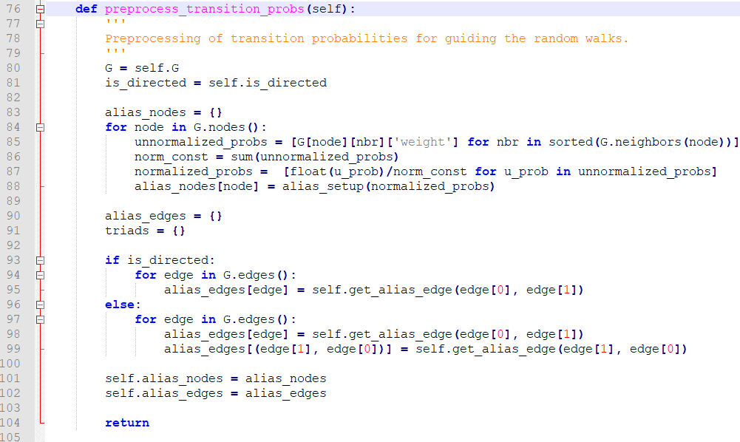

Slide 17
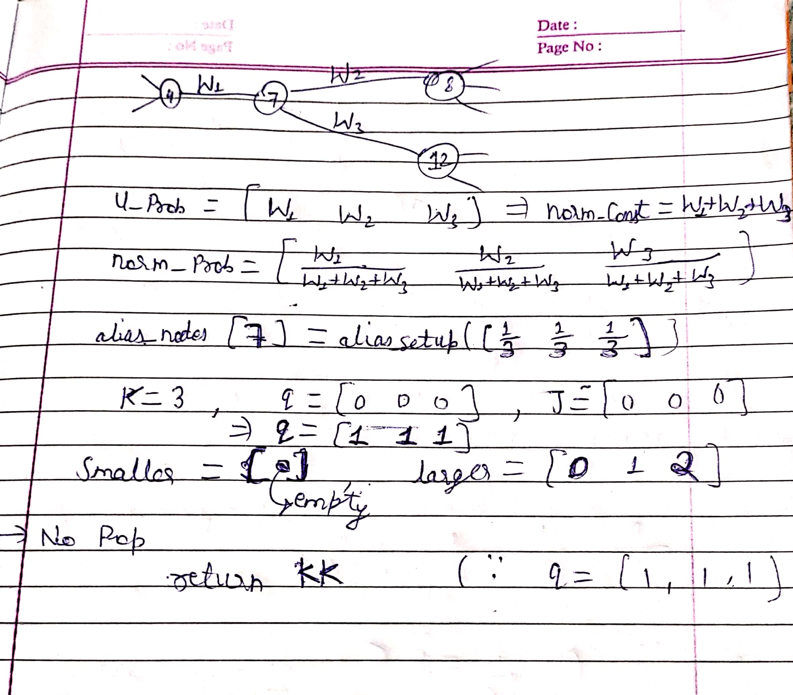

Slide 18
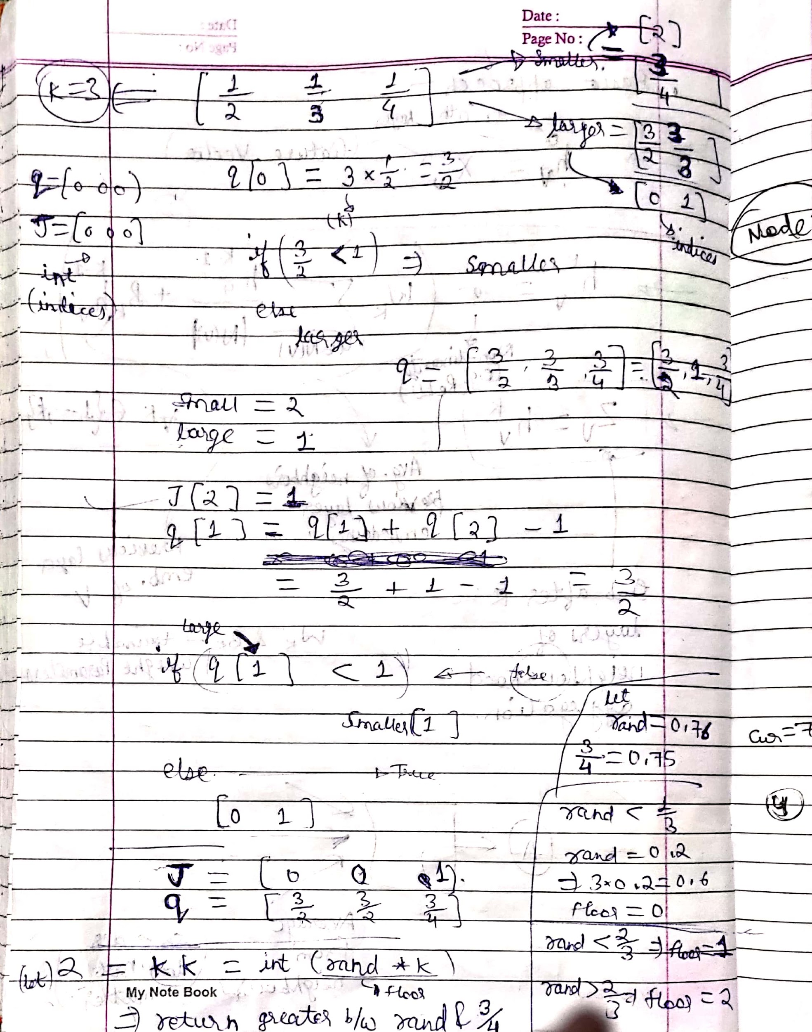

Slide 19
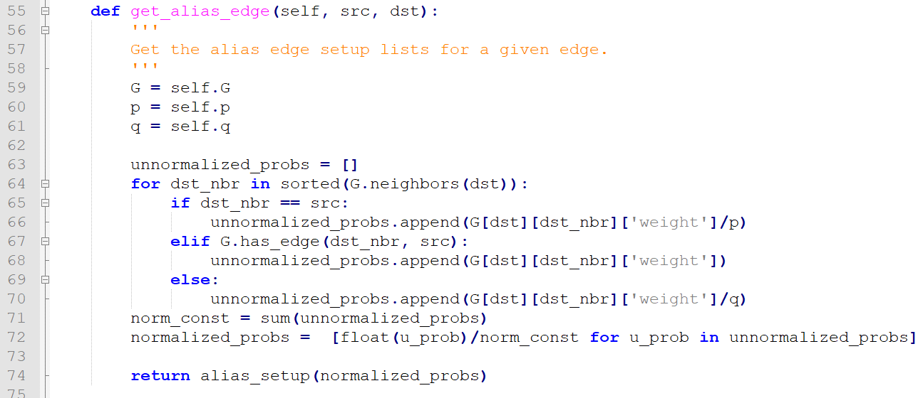
Probabilities with Memory -

Slide 20
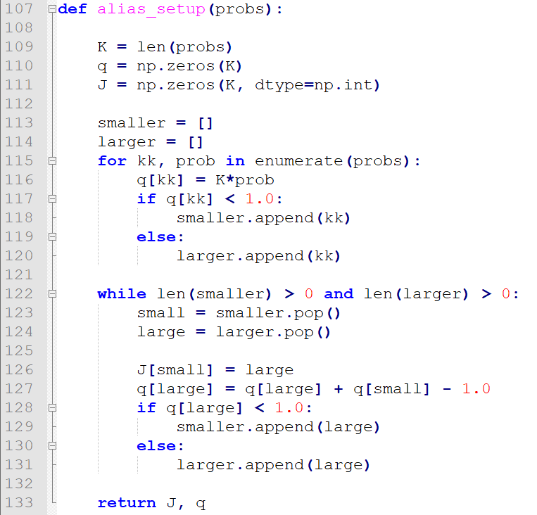
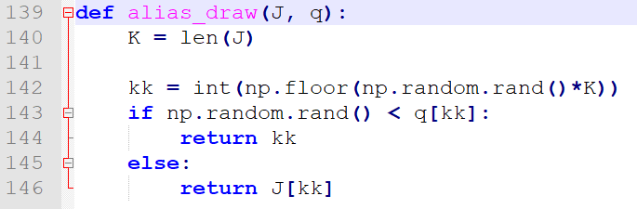
Alias Draw (integer)
Alias Setup (J, q)

Slide 21
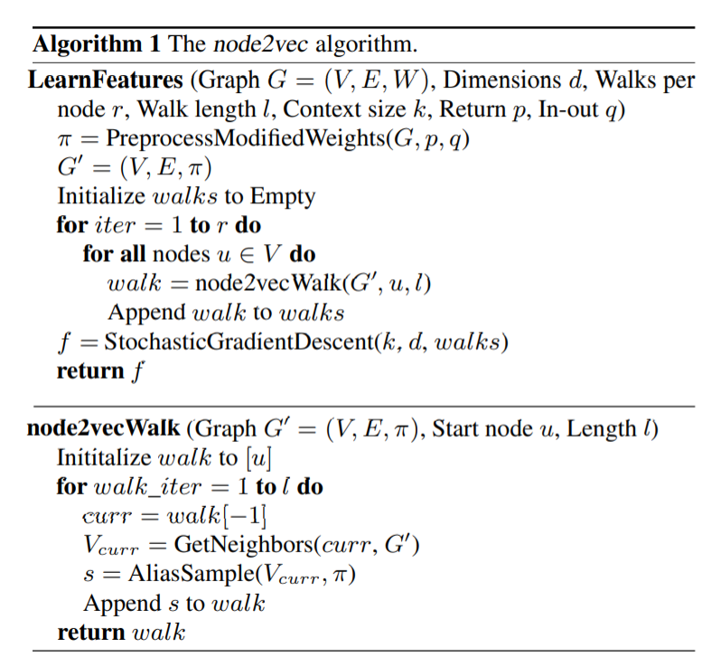

Slide 22
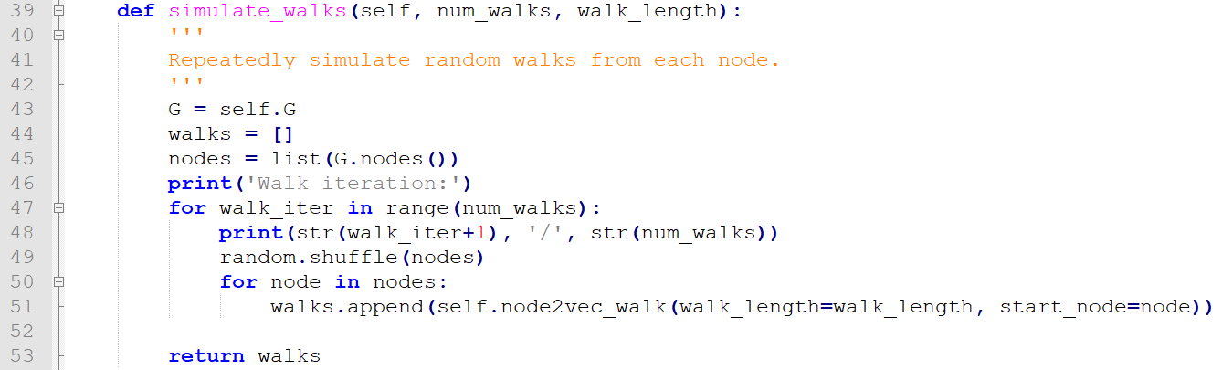
Simulating walks in numerous iterations. (Every single iteration consists of walks starting from every node present in the graph)

Slide 23
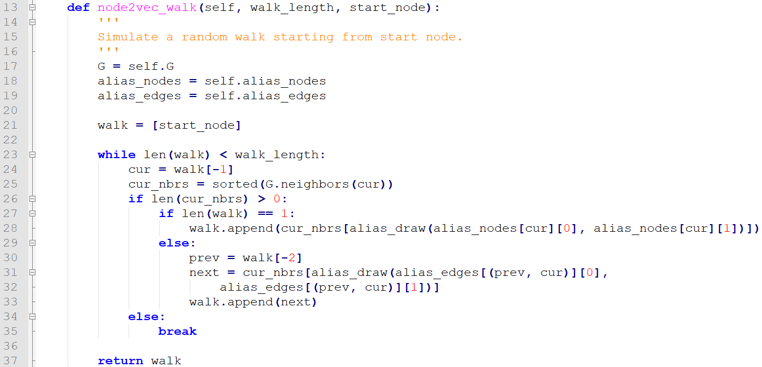
Single walk using node2vec (simulate walks use this function to generate a walk)

Slide 24
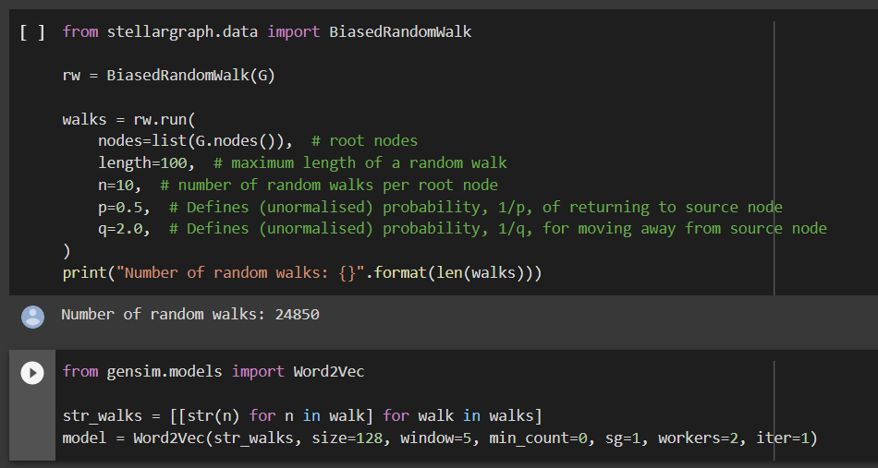
Using a different Random Walk (from stellargraph)-

Slide 25
Show Visualizations
t-SNE a non-linear dimensionality reduction algorithm finds patterns in the data by identifying observed clusters based on similarity of data points with multiple features. But it is not a clustering algorithm it is a dimensionality reduction algorithm.
It gives promising results for clustering as well. Comparison with cluster obtained via K-means clustering in the next slide yields that we can directly use clusters generated from t-SNE for visualization.

Slide 26
Embedding Projector –
https://projector.tensorflow.org/
Convert the embeddings into tensors and metadata file by running the script.
Alias Function Used –
https://lips.cs.princeton.edu/the-alias-method-efficient-sampling-with-many-discrete-outcomes/

Slide 27
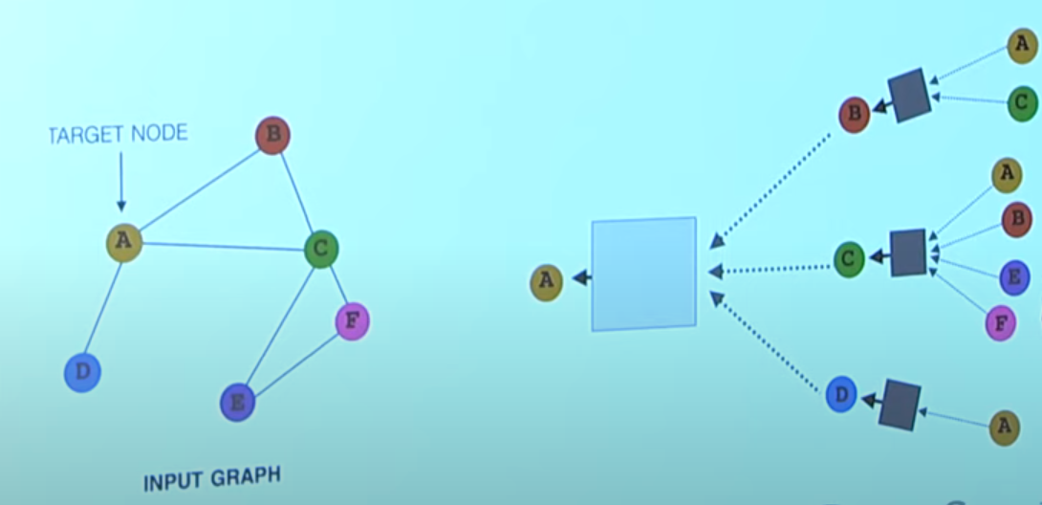
Key Idea

Slide 28
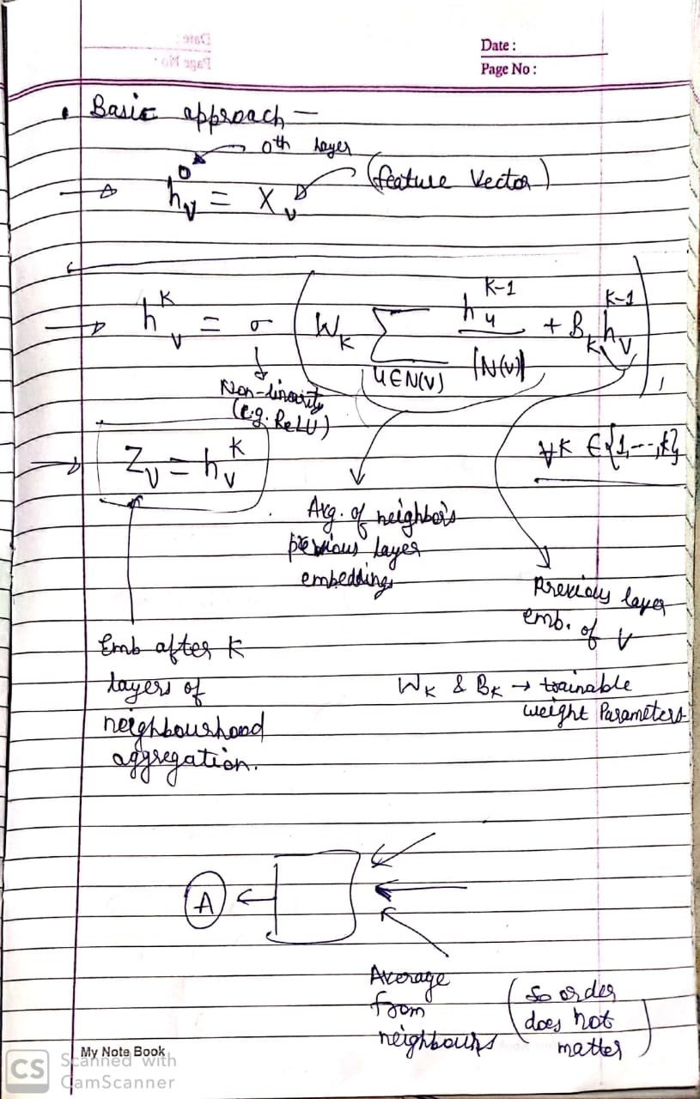

Slide 29
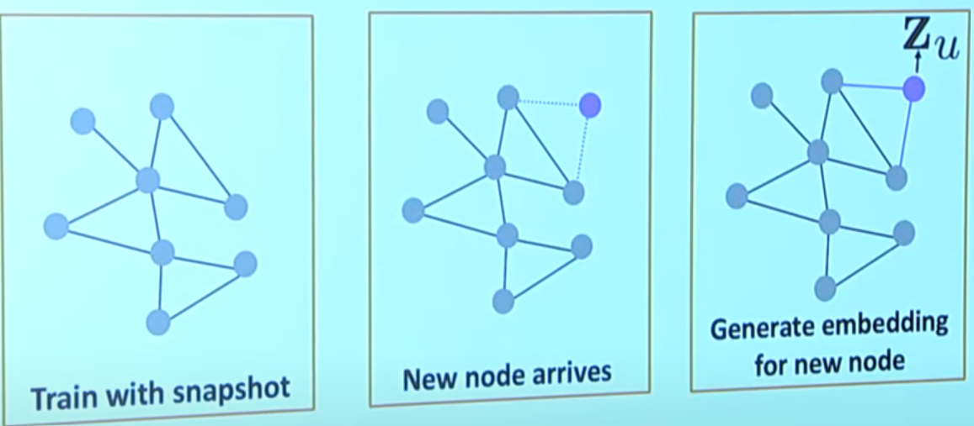

Slide 30
Graph Algorithms for Dark Web analysis

Slide 31
Contents…….
Previous Work
Karate Club
Iron March embeddings
Basics of Graph and how is it useful
Node2Vec and embeddings
Algorithms in Research Paper
New approaches
Various other algorithms/methodologies

Slide 32
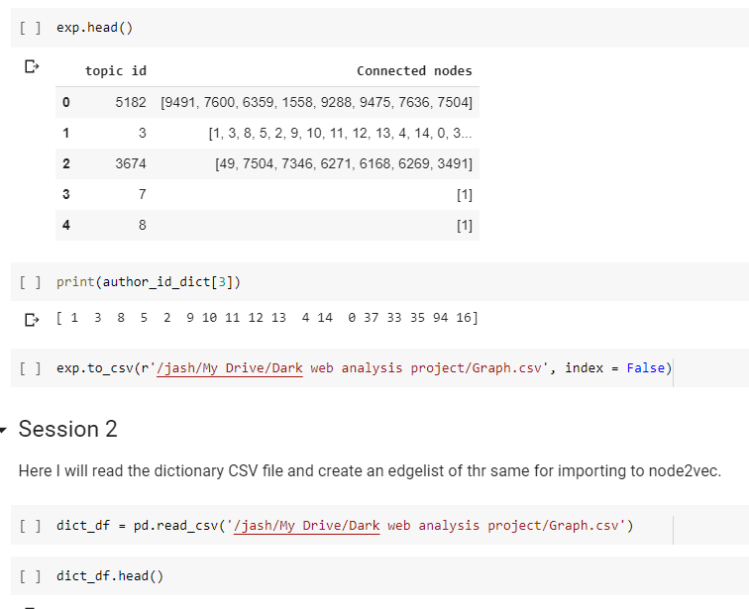
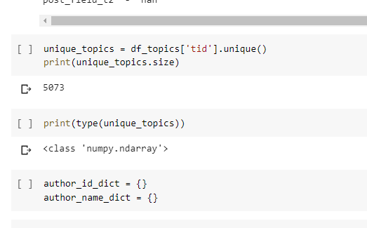

Slide 33
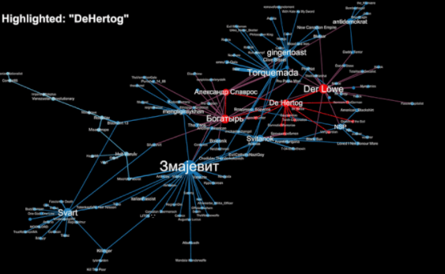
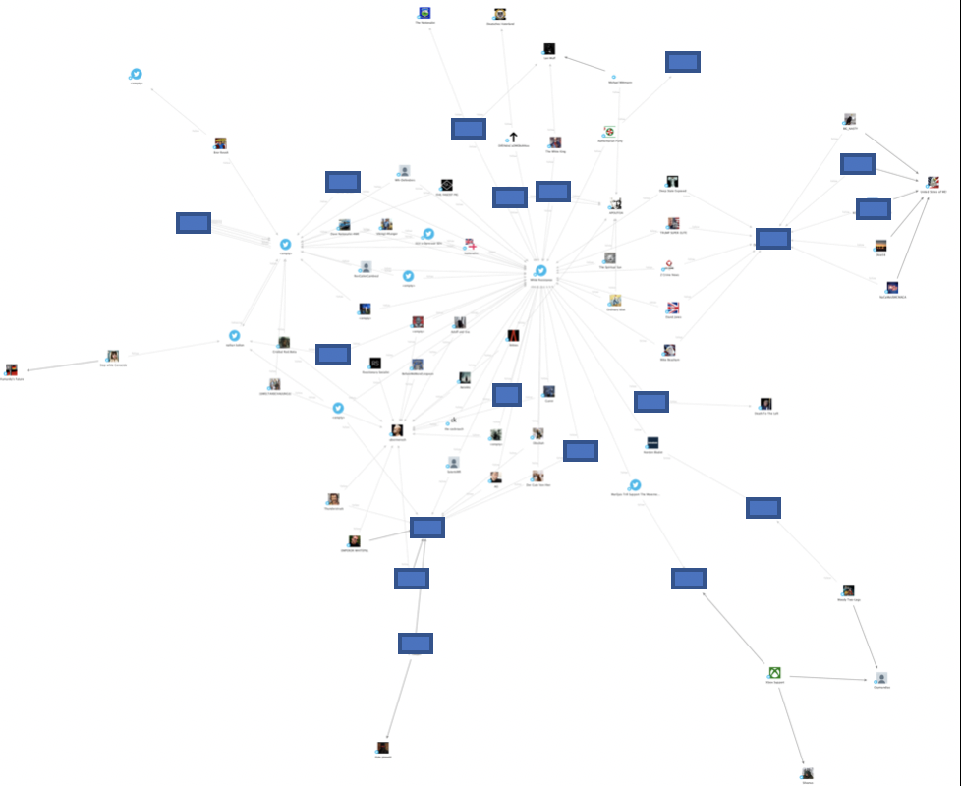

Slide 34
#1 Previous Works - Karate Club
The data points represent people enrolled in the Karate club.
Nodes 1 and 34 represent the Sensei and Owner respectively.
The motivation for the analysis was the fact that they wanted to separate and hence, had to analysis as to how many students would join whom.
The 3 - step algorithm is to make the graph embeddings ( preparation step ) and then make clusters ( analysis step ) and then plotting them ( visualization step ).

Slide 35
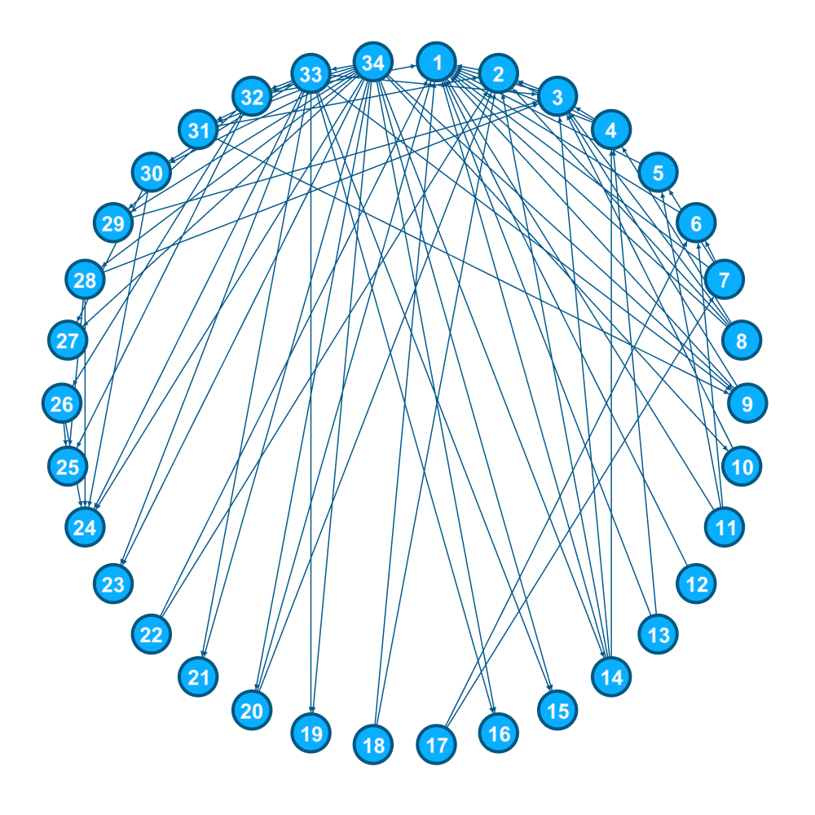
Node 1 is the Sensei.
Node 34 is the owner.
We need to use the structural features to find out who joins whom.
https://en.wikipedia.org/wiki/Zachary%27s_karate_club

Slide 36
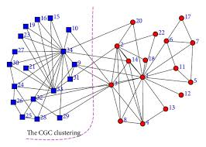
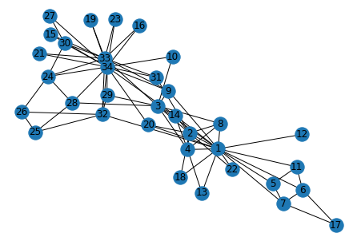
Reason : Random Walks are actually random !!!!
Applied PCA to reduce the dimensions to 2 from 128
Only Mismatch are Node 14, 3, 20
And that too, they are very close to both of them

Slide 37
How it can be useful
Social Network analysis
Community Detection
Link Prediction
Relational ripple effect
Manipulate Unstructured data
Knowledge graphs
Structural Boot-strapping
Geometrical Analysis
Correlational ratio

Slide 38
#3 Node2Vec and Embeddings
Read the parameters
Graph
P - controlling the BFS
Q - controlling the DFS
Pre-process the probabilities
Simulate the walk
No. of iterations
Walk length
Gensim - Word2vec
Embedding length
Window size

Slide 39
Clustering of the embeddings
Hierarchical clustering
Centroid-based clustering
Graph-based clustering
Density-based clustering
Amalgamation

Slide 40
#4 Further Algorithms analysed
GCNs
Methods for link prediction
Random walks based
Deep Walk and Node2Vec
LINE
GraphSAGE
Tensor based
RESCEL
TransE
Positive Sampling

Slide 41
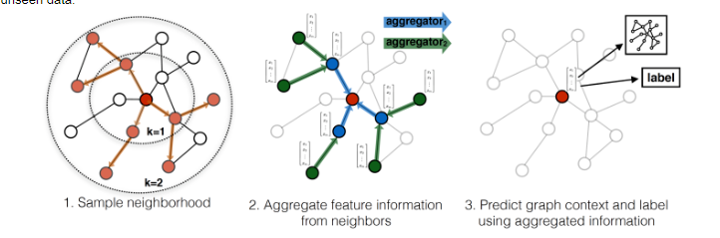
Graph SAGE

Slide 42
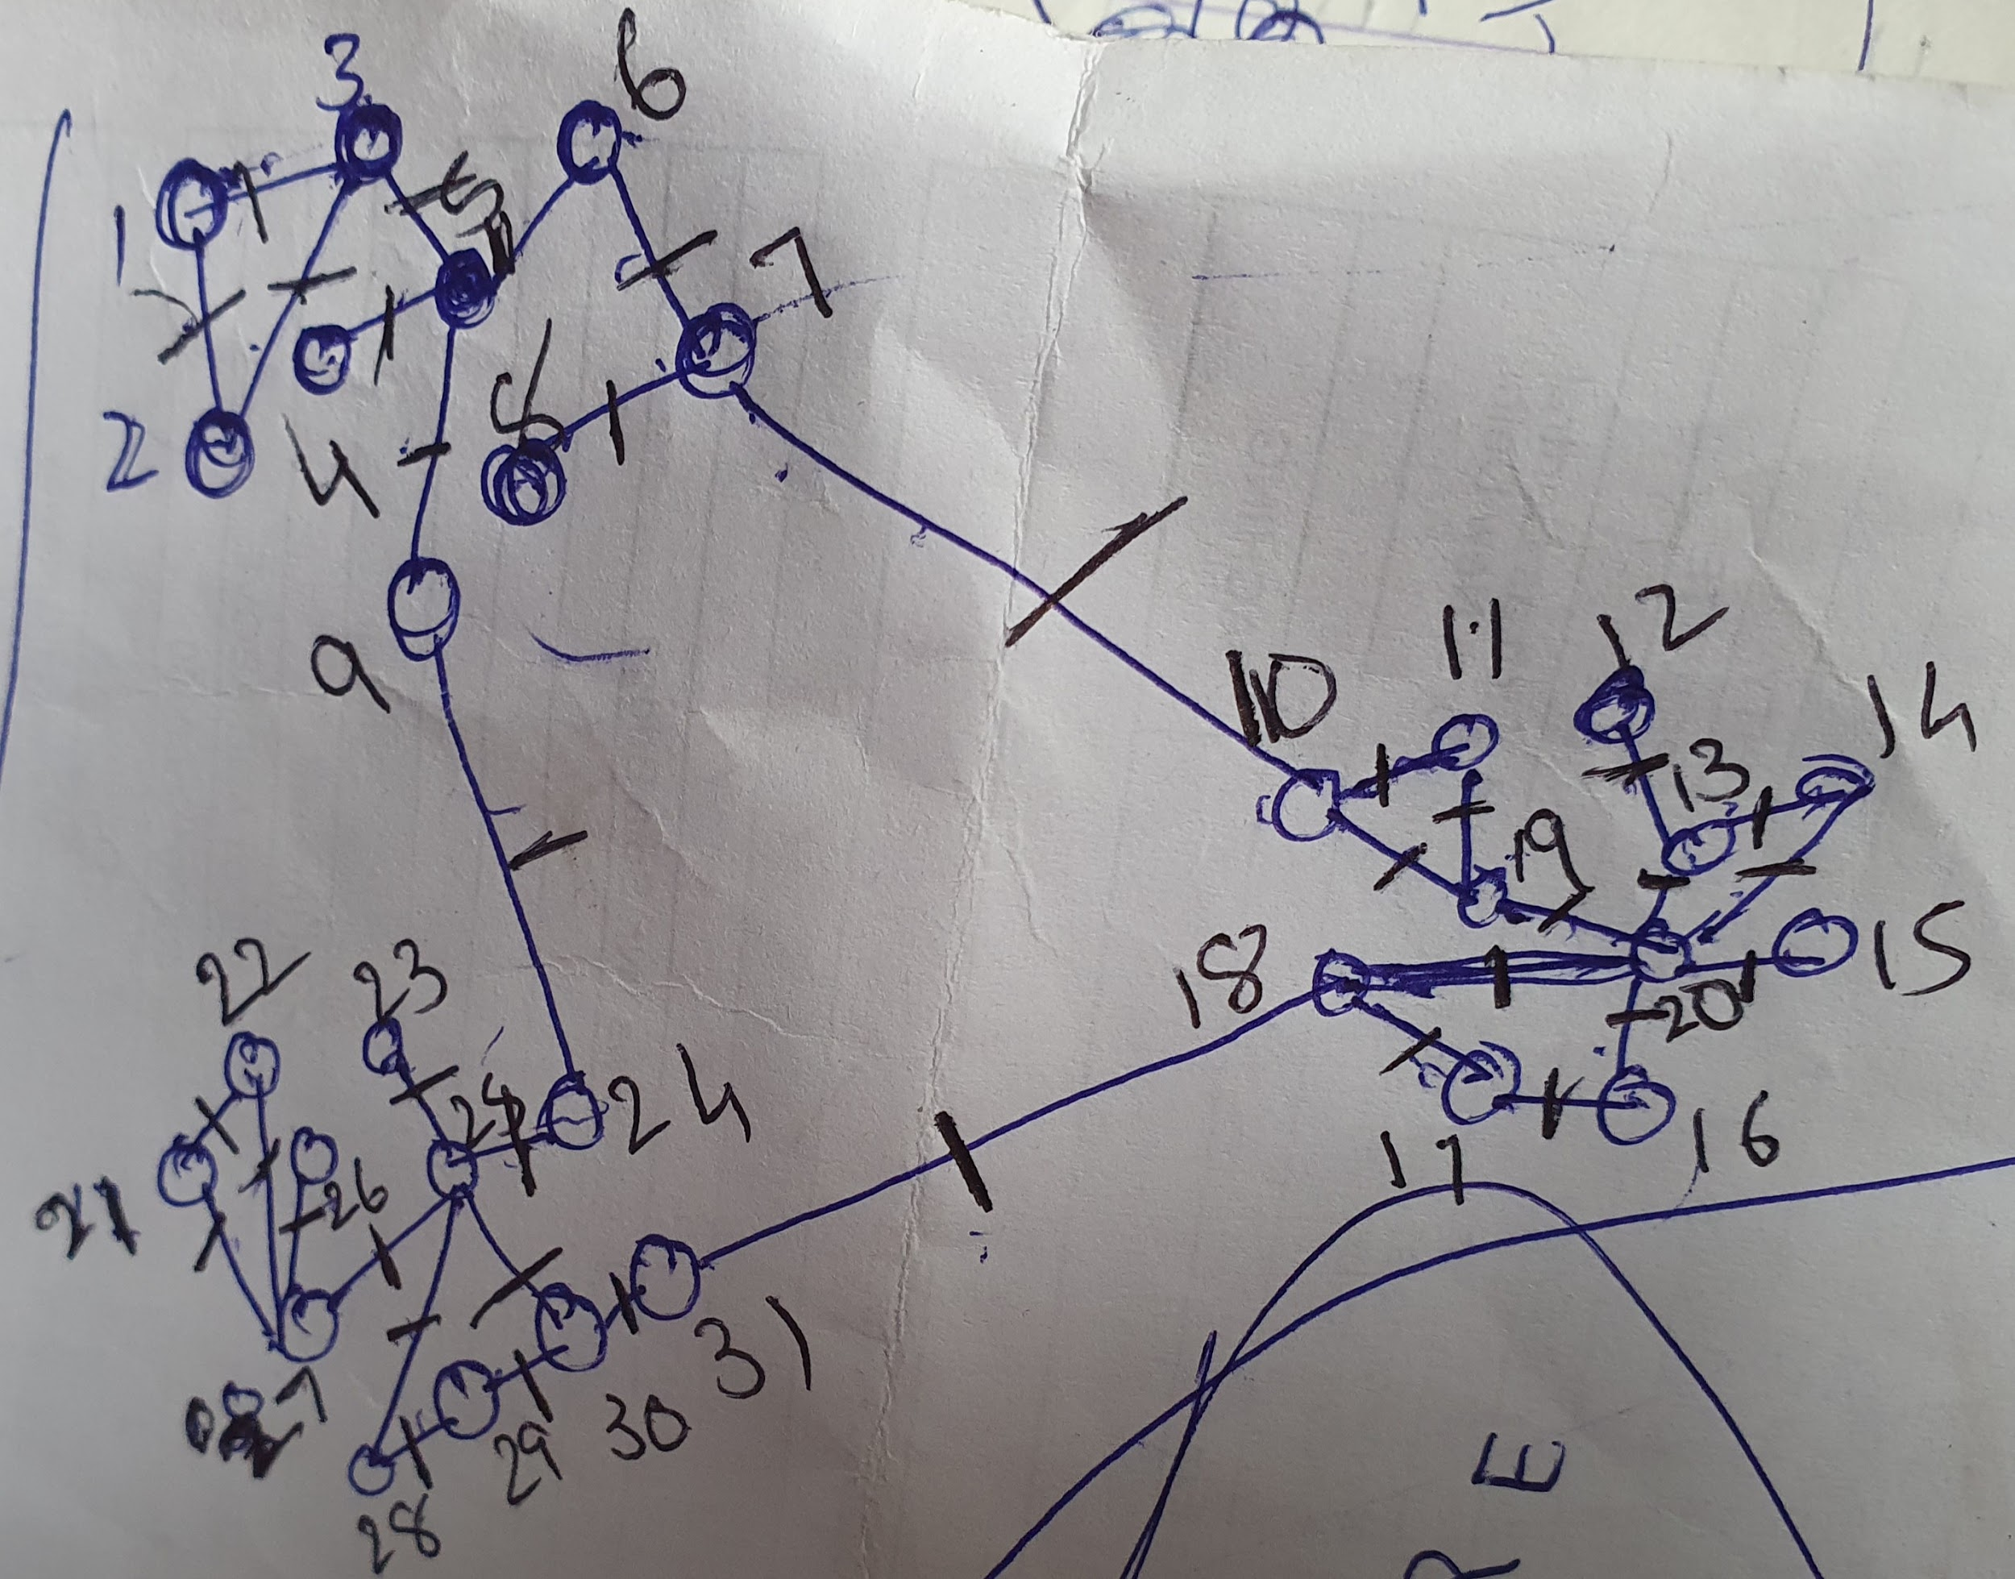
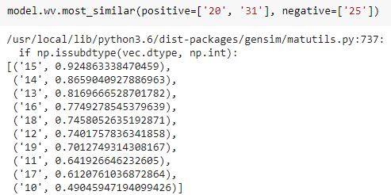
Gateway detection
https://colab.research.google.com/drive/1TtUoMROJv3P0ZGuboYRbrwKGmiiSlNL5#scrollTo=MAipZzUXo7uO

Slide 43
Link Prediction on Ego Facebook dataset

Slide 44
General Overview
Link prediction on top of node representations/embeddings. The embeddings are computed with the node2vec algorithm. After obtaining embeddings, a binary classifier can be used to predict a link, or not, between any two nodes in the graph.
There are four steps:
1. Obtain embeddings for each node
2. For each set of hyperparameters, train a classifier
3. Select the classifier that performs the best
4. Evaluate the selected classifier on unseen data to validate
its ability to generalise
StellarDiGraph: Directed multigraph Nodes: 4039, Edges: 88234 Node types: default: [4039] Features: none Edge types: default-default->default Edge types: default-default->default: [88234] Weights: all 1 (default) Features: none

Slide 45
Splitting the dataset
For computing node embeddings, a Train Graph (graph_train)
For training classifiers, a classifier Training Set (examples_train) of positive and negative edges that weren't used for computing node embeddings
For choosing the best classifier, an Model Selection Test Set (examples_model_selection) of positive and negative edges that weren't used for computing node embeddings or training the classifier
For the final evaluation, a Test Graph (graph_test) to compute test node embeddings with more edges than the Train Graph, and a Test Set (examples_test) of positive and negative edges not used for neither computing the test node embeddings or for classifier training or model selection

Slide 46
Preparing Dataset
# Defining an edge splitter on the original graph: edge_splitter_test = EdgeSplitter(graph) # Randomly sample a fraction p=0.1 of all positive links, and same number of negative links, from graph, and obtain the reduced graph graph_test with the sampled links removed: graph_test, examples_test, labels_test = edge_splitter_test.train_test_split( p=0.5, method="global", keep_connected=True ) print(graph_test.info())
** Sampled 44117 positive and 44117 negative edges. ** StellarDiGraph: Directed multigraph Nodes: 4039, Edges: 44117 Node types: default: [4039] Features: none Edge types: default-default->default Edge types: default-default->default: [44117] Weights: all 1 (default) Features: none

Slide 47
Apply node2vec and generate embeddings then Train and evaluate the link prediction model
We calculate link/edge embeddings for the positive and negative edge samples by applying a binary operator on the embeddings of the source and target nodes of each sampled edge.
Given the embeddings of the positive and negative examples, we train a logistic regression classifier to predict a binary value indicating whether an edge between two nodes should exist or not.
We evaluate the performance of the link classifier for each of the 4 operators on the training data with node embeddings calculated on the Train Graph (graph_train), and select the best classifier.
The best classifier is then used to calculate scores on the test data with node embeddings calculated on the Test Graph (graph_test).

Slide 48
Training Classifier
# 1. link embeddings def link_examples_to_features(link_examples, transform_node, binary_operator): return [ binary_operator(transform_node(src), transform_node(dst)) for src, dst in link_examples ] # 2. training classifier def train_link_prediction_model( link_examples, link_labels, get_embedding, binary_operator ): clf = link_prediction_classifier() link_features = link_examples_to_features( link_examples, get_embedding, binary_operator ) clf.fit(link_features, link_labels) return clf def link_prediction_classifier(max_iter=2000): lr_clf = LogisticRegressionCV(Cs=10, cv=10, scoring="roc_auc", max_iter=max_iter) return Pipeline(steps=[("sc", StandardScaler()), ("clf", lr_clf)])

Slide 49
Visualisation using PCA
# Calculate edge features for test data link_features = link_examples_to_features( examples_test, embedding_test, best_result["binary_operator"] ) # Learn a projection from 128 dimensions to 2 pca = PCA(n_components=2) X_transformed = pca.fit_transform(link_features) # plot the 2-dimensional points plt.figure(figsize=(16, 12)) plt.scatter( X_transformed[:, 0], X_transformed[:, 1], c=np.where(labels_test == 1, "b", "r"), alpha=0.5, )

Slide 50
Evaluating Classifier
# 3. and 4. evaluate classifier def evaluate_link_prediction_model( clf, link_examples_test, link_labels_test, get_embedding, binary_operator ): link_features_test = link_examples_to_features( link_examples_test, get_embedding, binary_operator ) score = evaluate_roc_auc(clf, link_features_test, link_labels_test) return score def evaluate_roc_auc(clf, link_features, link_labels): predicted = clf.predict_proba(link_features) # check which class corresponds to positive links positive_column = list(clf.classes_).index(1) return roc_auc_score(link_labels, predicted[:, positive_column])

Slide 51
Choosing the operator giving best performance
def operator_hadamard(u, v): return u * v def operator_l1(u, v): return np.abs(u - v) def operator_l2(u, v): return (u - v) ** 2 def operator_avg(u, v): return (u + v) / 2.0
We consider 4 different operators: 1. Hadamard 2. L1 3. L2 4. average The paper provides a detailed description of these operators. All operators produce link embeddings that have equal dimensionality to the input node embeddings (128 dimensions for our example).

Slide 52
Training our best model
def run_link_prediction(binary_operator): clf = train_link_prediction_model( examples_train, labels_train, embedding_train, binary_operator ) score = evaluate_link_prediction_model( clf, examples_model_selection, labels_model_selection, embedding_train, binary_operator, ) return { "classifier": clf, "binary_operator": binary_operator, "score": score, } #binary_operators = [operator_hadamard] binary_operators = [operator_hadamard, operator_l1, operator_l2, operator_avg]

Slide 53
Evaluating Final Score
Now that we've trained and selected our best model, we use a test set of embeddings and calculate a final evaluation score.
embedding_test = node2vec_embedding(graph_test, "Test Graph") test_score = evaluate_link_prediction_model( best_result["classifier"], examples_test, labels_test, embedding_test, best_result["binary_operator"], ) print( f"ROC AUC score on test set using '{best_result['binary_operator'].__name__}': {test_score}" )

Slide 54
Visualisation using PCA
# Calculate edge features for test data link_features = link_examples_to_features( examples_test, embedding_test, best_result["binary_operator"] ) # Learn a projection from 128 dimensions to 2 pca = PCA(n_components=2) X_transformed = pca.fit_transform(link_features) # plot the 2-dimensional points plt.figure(figsize=(16, 12)) plt.scatter( X_transformed[:, 0], X_transformed[:, 1], c=np.where(labels_test == 1, "b", "r"), alpha=0.5, )

Slide 55
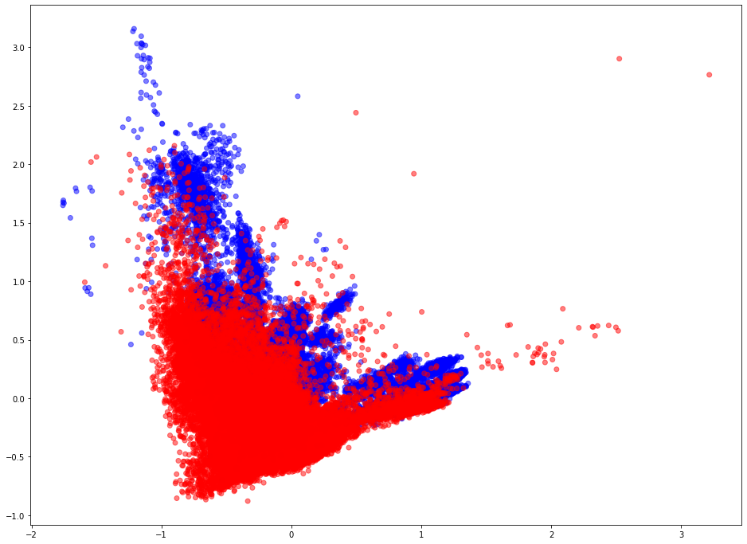

Slide 56
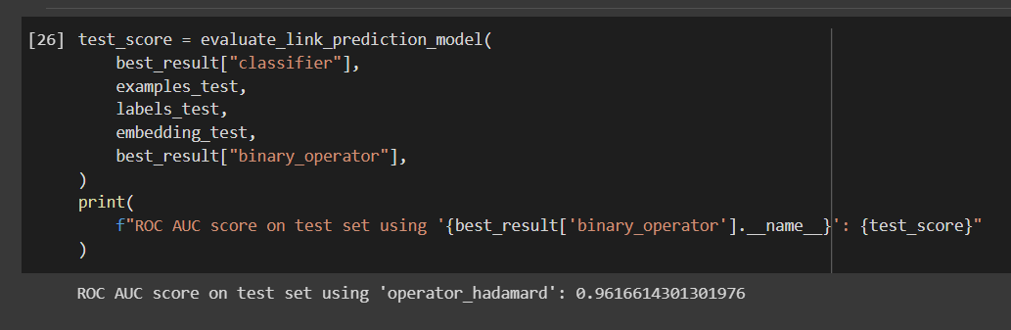
Result

Slide 57
What’s Next ?
Discuss the possibility of integration of GPT-3 API for classification of messages posted on forums as well the market listings.
Feasibility to use NLP.
Can we create a pipeline to receive market listings data in realtime to feed to our model.
Performing more tests in the Dataset.
Schedule an extensive discussion after compre for brainstorming.

Slide 58
The End

